Slide 1
HOTEL MANAGEMENT SYSTEM
Presented to:
Ms. Sidra Khalid
Prepared by:
M. Raed Sajid (22I-0968)
Gulzar Amin (22I-8810)

Slide 2
CONTENTS
1
INTRODUCTION
2
DESCRIPTION
3
SOME USE CASES
4
SOME PICTURES

Slide 3

INTRODUCTION
The Hotel Management System (HMS) is a comprehensive software solution designed to streamline the operations of a hotel. This project is developed in Java and integrates a relational database to manage various hotel functions efficiently. The system aims to enhance customer experience and optimize hotel operations through automation and real-time data management.
Notes:
3

Slide 4

DESCRIPTION
To automate the booking and reservation process.
To manage customer information and room availability efficiently.
To streamline check-in and check-out procedures.
To maintain real-time records of hotel operations, including billing and payment processing.
To provide an intuitive user interface for hotel staff/administrators.

Slide 5
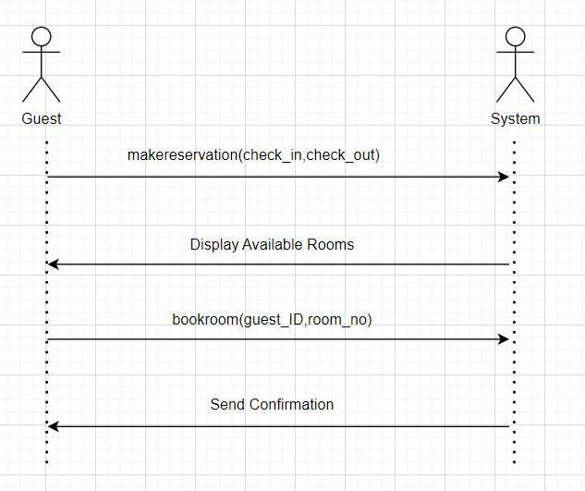

Slide 6
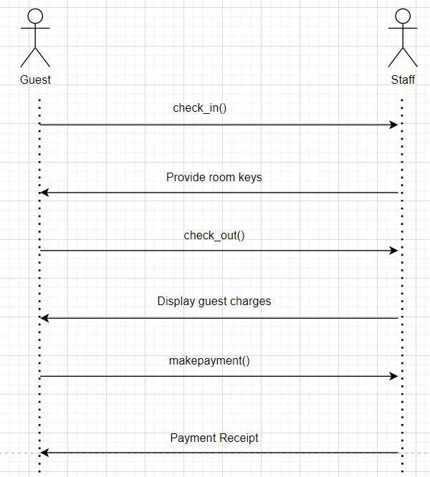

Slide 7
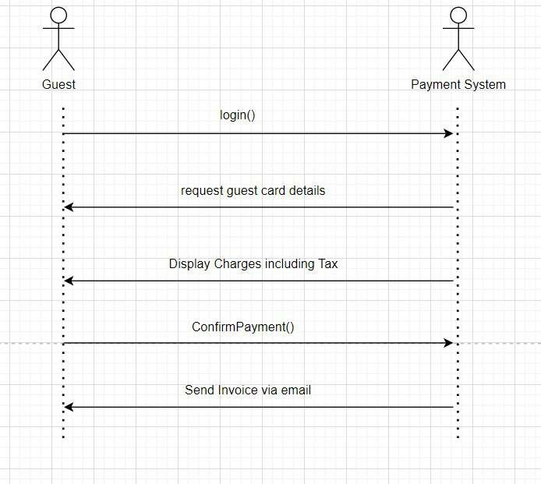

Slide 8
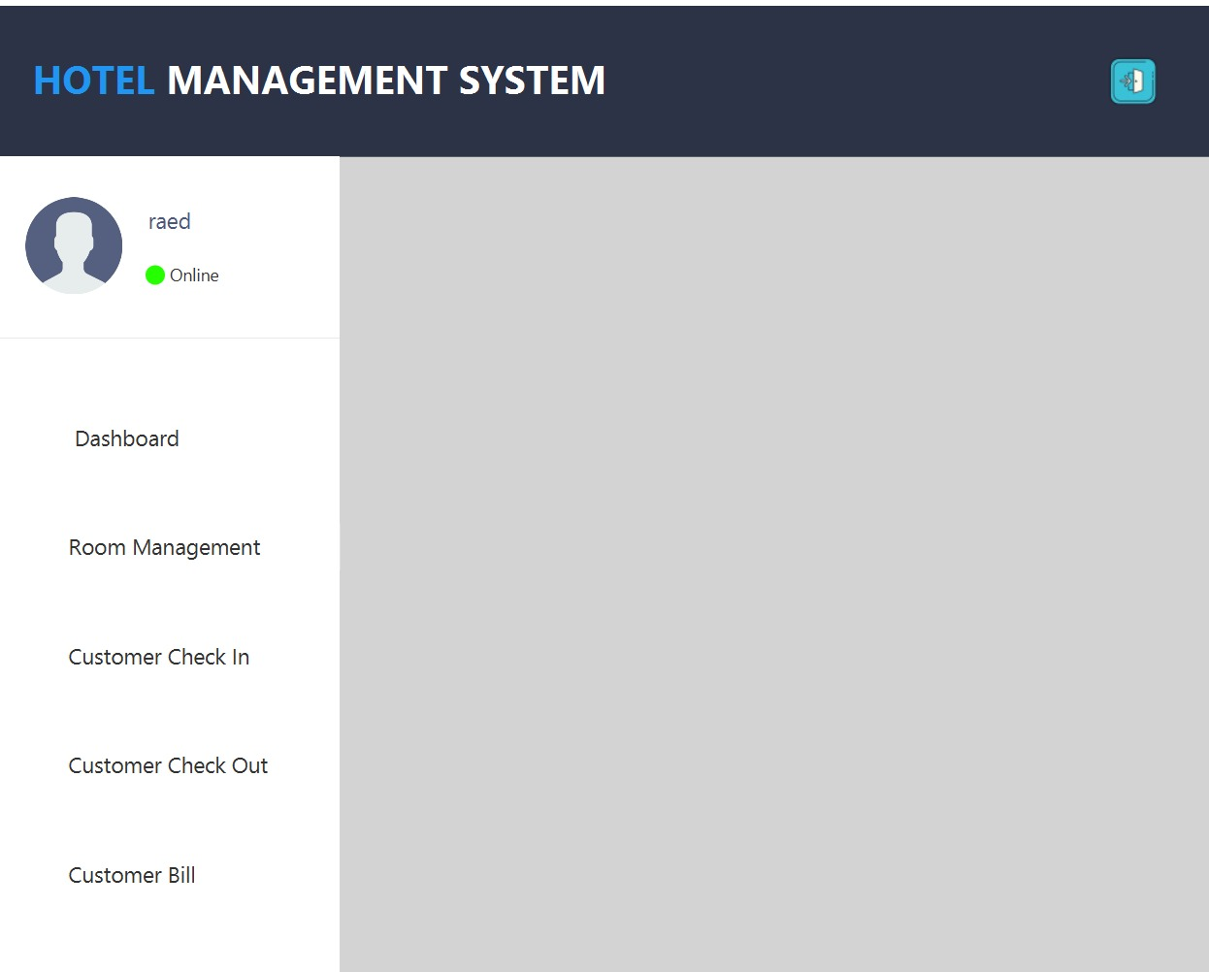

Slide 9
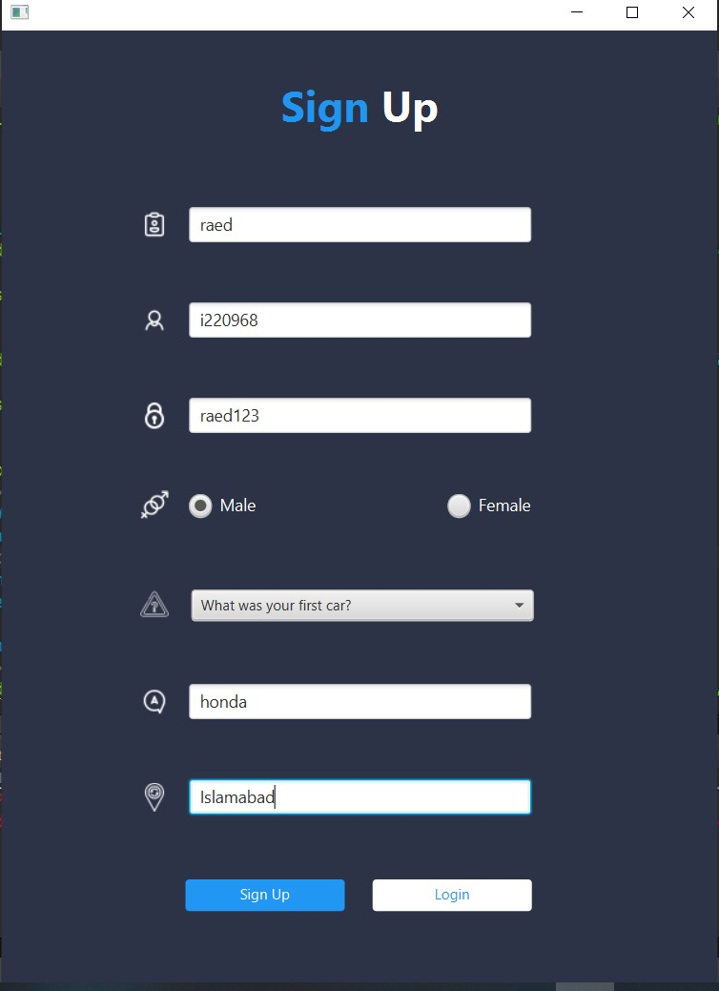

Slide 10
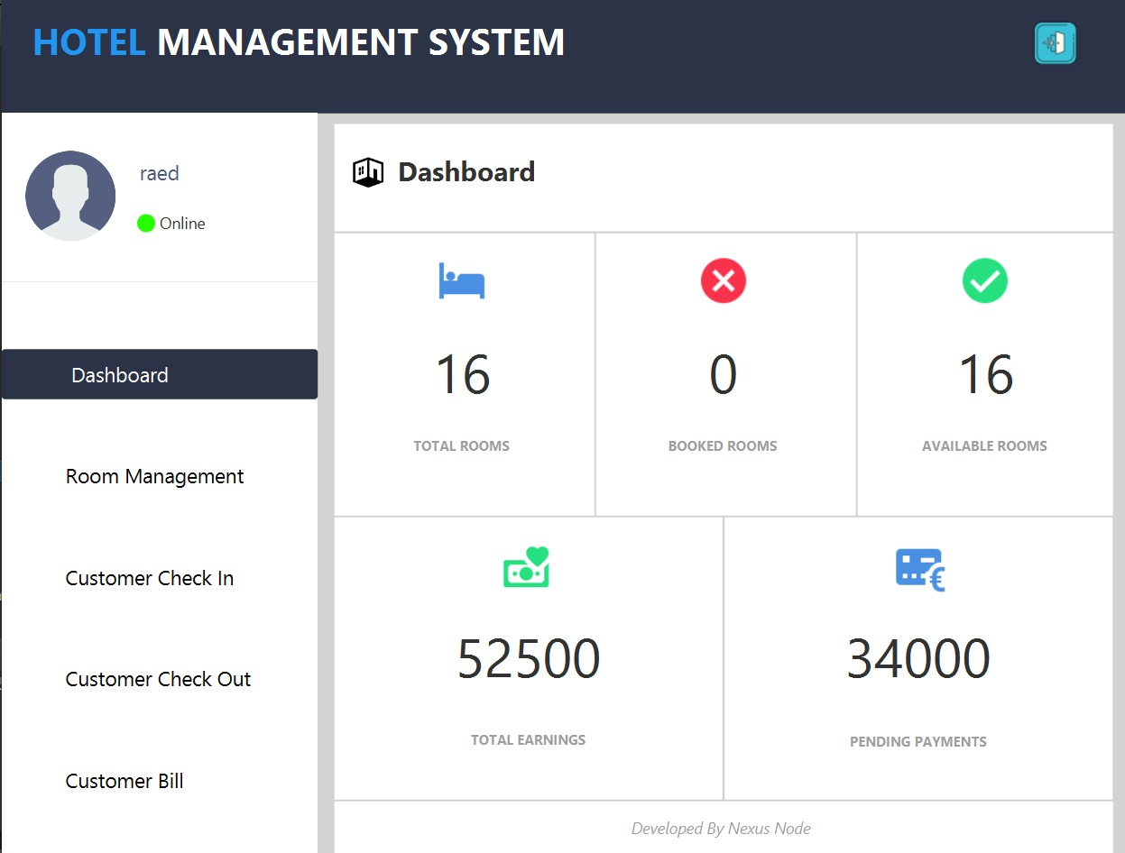

Slide 11
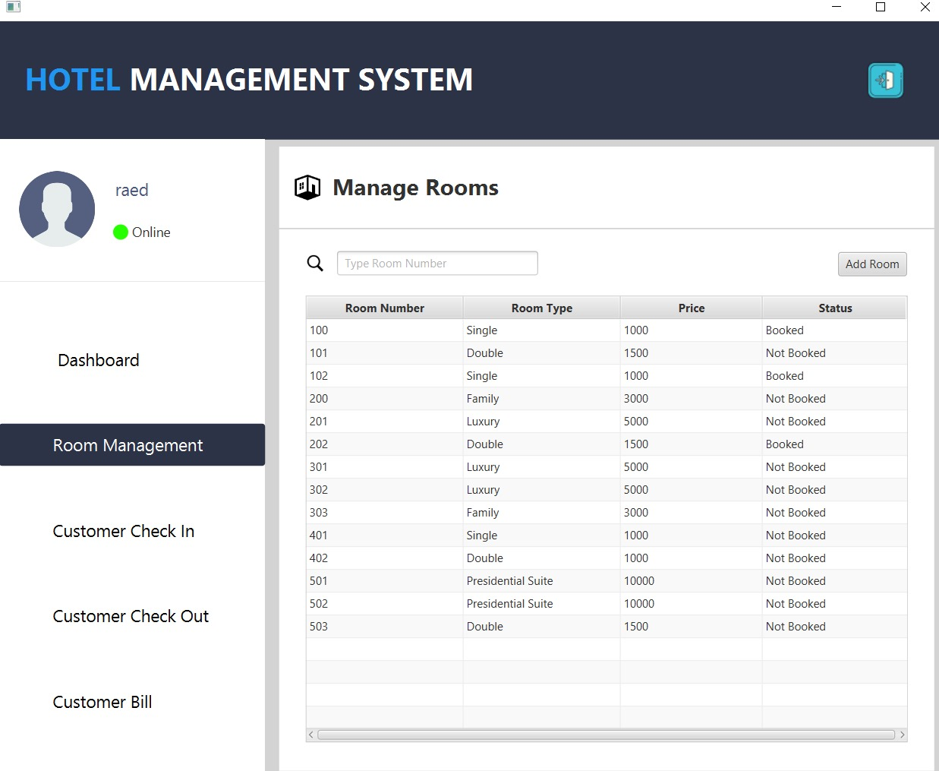

Slide 12
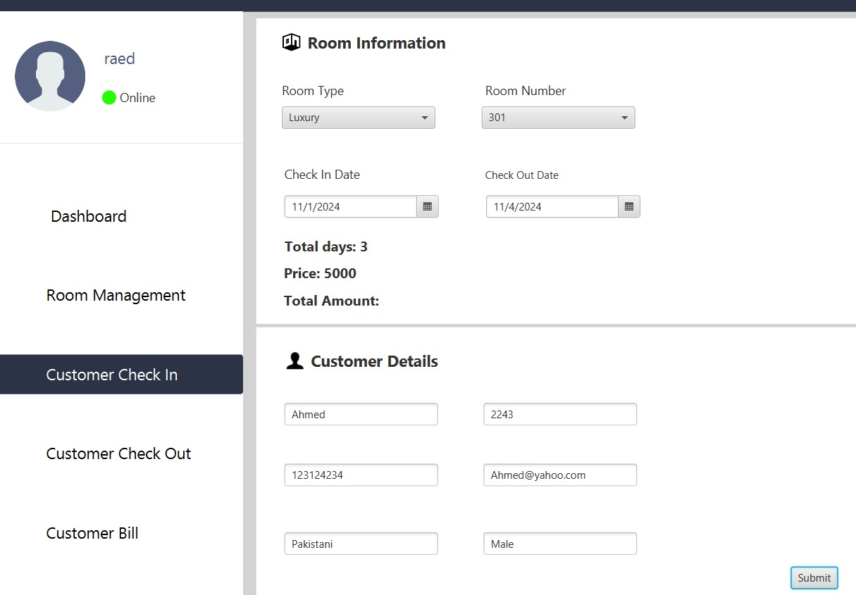

Slide 13
Thanks

